Slide 1
Winning The Race Every Day!

Slide 2
Winning The Race Every Day!
"Do you not know that in a race all the runners run, but only one gets the prize? Run in such a way as to get the prize."
1 Corinthians 9:24

Slide 3
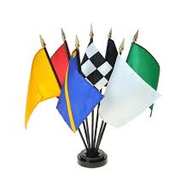
GOD’S SIGNALS TO US

Slide 4
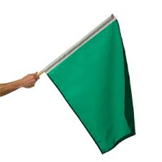
The Green Flag
"But you will receive power when the Holy Spirit comes on you; and you will be my witnesses in Jerusalem, and all Judea and Samaria, and to the Ends of the earth." Acts 1:8

Slide 5
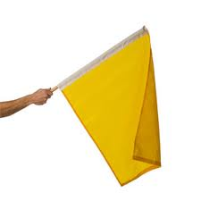
The Yellow Flag
"Do not get drunk on wine, which leads to debauchery. Instead, be filled with the Holy Spirit." Ephesians 5:18

Slide 6
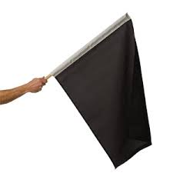
The Black Flag
"If we confess our sins, he is faithful and just and will forgive us our sins and purify us from all unrighteousness." 1 John 1:9

Slide 7
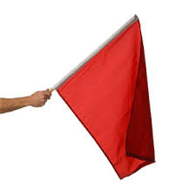
The Red Flag
"And we know that in all things God works for the good of those who love him, who have been called according to his purpose." Romans 8:28

Slide 8
The Blue Flag
"Therefore, since we are surrounded by such a great cloud of witnesses, let us lay aside everything that hinders… and let us run with perseverance the race marked out for us…” Hebrews 12:1-3

Slide 9
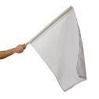
The White Flag
"Just as man is destined to die once, and after that face judgment." Hebrews 9:27

Slide 10
The Checkered Flag
"His master replied, "Well done, good and faithful servant! You have been faithful with a few things; I will put you in charge of many things. And share your masters happiness." Matthew 25:23

Slide 11
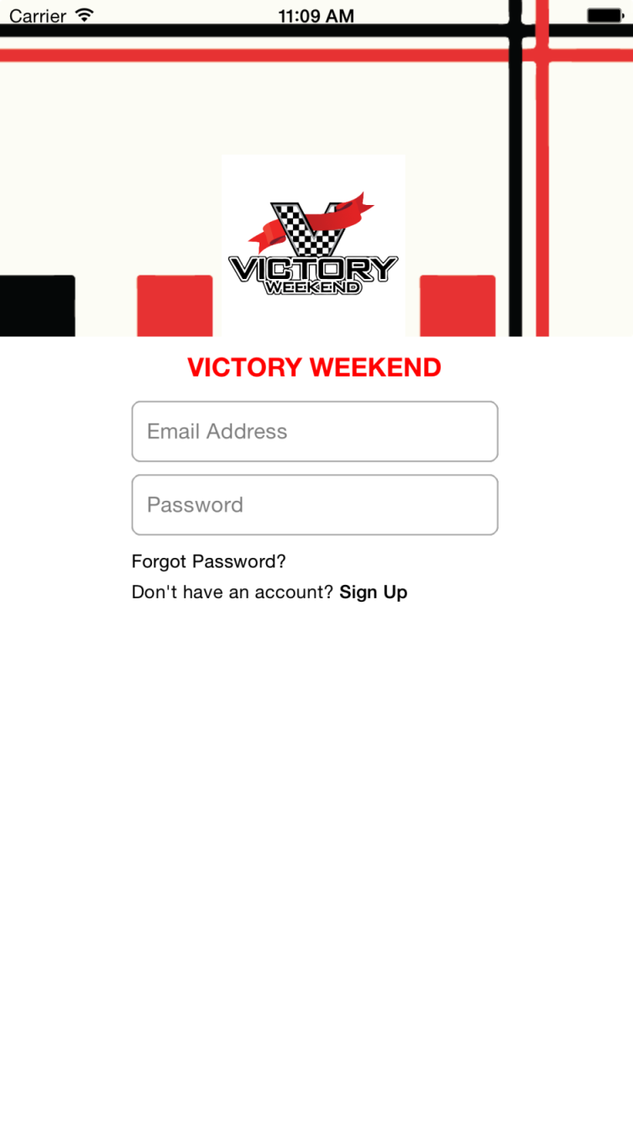
Stay connected…
Search for “Victory Weekend” in your app store. Receive Scripture daily based on your own spiritual needs.
FREE TO DOWNLOAD

